Slide 1




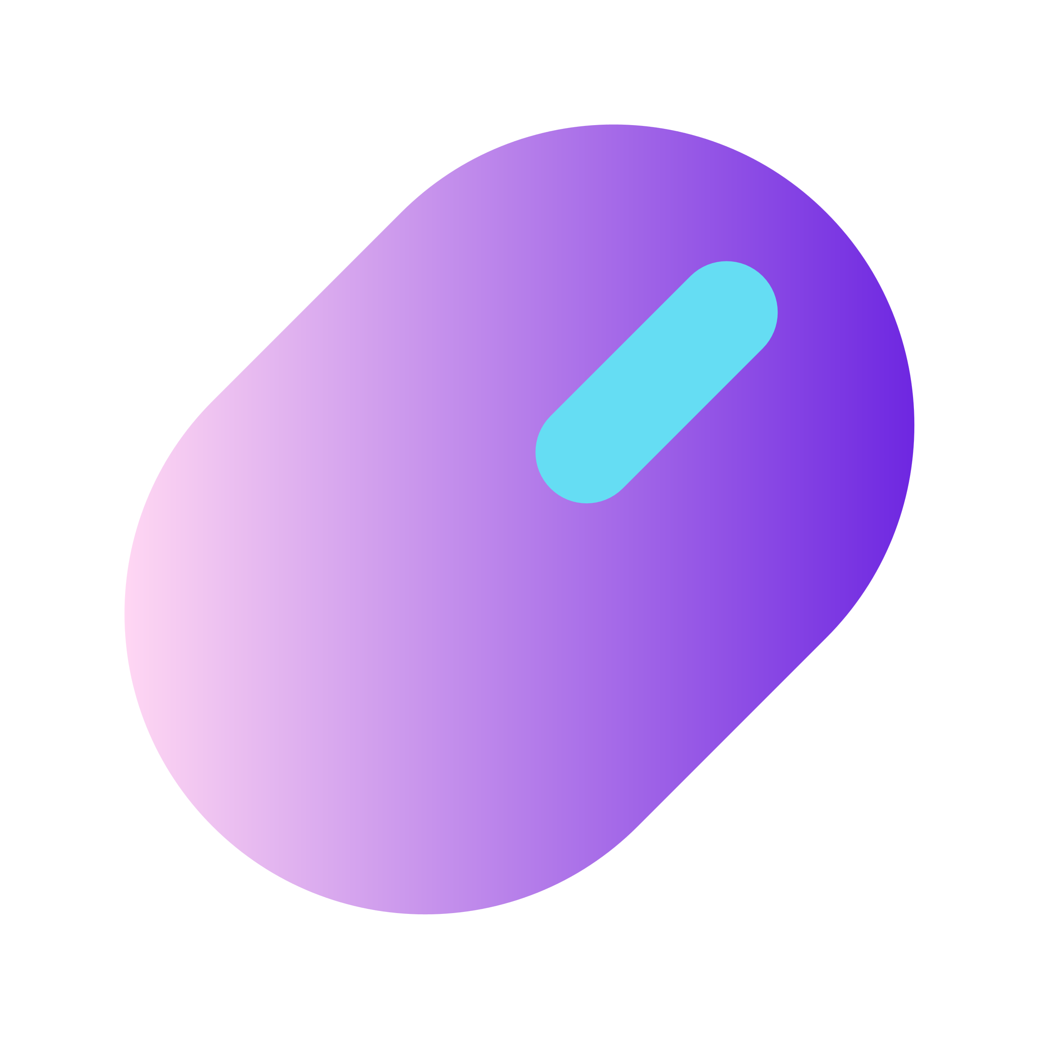

DPPS
Dynamic Programming for Problem Solver

Slide 2




Name | ID
Ali Ragab | 2100462
Paula Essam | 2101446
Mohamed Kamal | 2101218
Zeyad Taleet | 2101914
Basant Mohamed | 2101881
Fatma Waleed | 2100709
Reem Mohsen | 2101491
Under supervision
DR/ Basem Mohamed
Professor at the Egyptian E-learning university
Eng/ Fatma Mohamed Seoudi
Teaching assistant

Slide 3


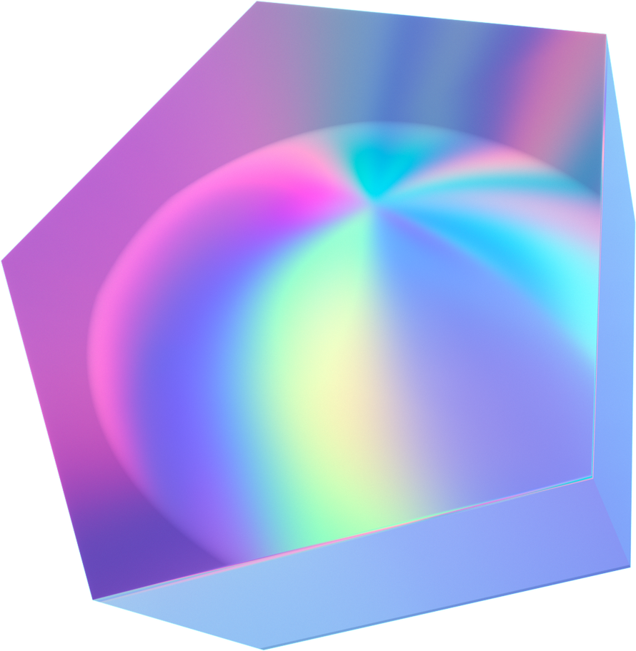

Table of Content
1-Introduction
6-Features
5-Previous work
2- Problem Definition
3-Motivations And Objectives
4-Suggested solution
9-Prototype
7-System Life Cycle
12-References
11-Conclusion
8-Design
10-Implementation Tools

Slide 4

01.
Introduction

Slide 5
Introduction
Project that involves developing a website to assist problem solvers and competitive programmers with unique features aimed at enhancing user experience. The project is called "DPPS," which stands for "Dynamic Programming for Problem Solver “ Integration with other platforms Allowing users to submit solutions to problems through various platforms and facilitating interactions.
AI chatbot Assisting users with problem-solving and technical guidance.

Slide 6
02.
Problem Definition

Slide 7
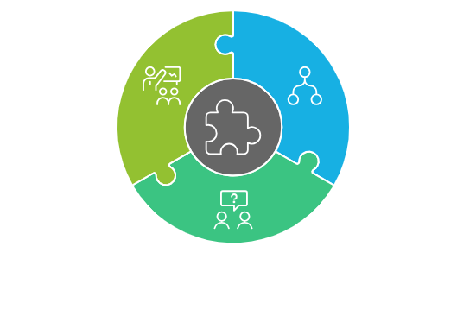
Problem Definition
Fragmented Workflow:
Navigating between platforms like Codeforces, LeetCode, and CodeChef wastes valuable time for problem solvers.
Switching contexts disrupts focus and reduces training efficiency.
Challenges in Team-Based Problem-Solving:
Preparing for onsite contests like ICPC is difficult due to limited collaboration tools.
Team members struggle to manage shared problem-solving workflows effectively.
Coaching and Training Limitations:
Coaches lack efficient tools to create, organize, and distribute private problem sets to trainees.
Collaboration and monitoring progress become cumbersome, hindering effective contest preparation.

Slide 8
03.
Motivations And Objectives

Slide 9
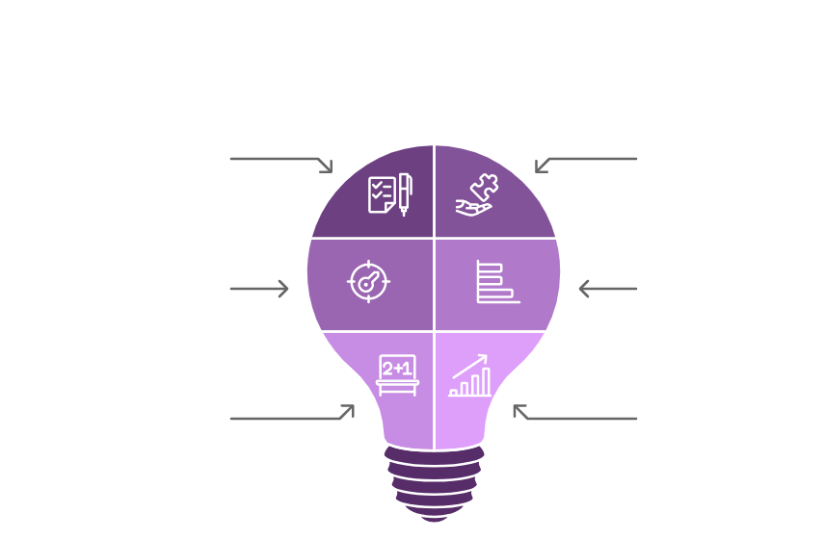

Slide 10
04.
Suggested solution

Slide 11


Suggested solution
Unified Problem Platform
Member Collaboration Tool
Enhanced Learning and Preparation
Advanced Coaching Features
Consolidates problems from multiple competitive programming websites using web crawling and scraping technologies to provide a single interface.
Enables members to solve problems collectively, participate in team-based contests, and improve teamwork in preparation for competitions.
Provides tools for coaches to manage private problem sets, share progress, monitor trainees, and host custom contests for targeted training.
Offers features like performance tracking, intelligent hints, and chatbot assistance to improve learning efficiency and contest readiness.

Slide 12
05.
Previous work

Slide 13
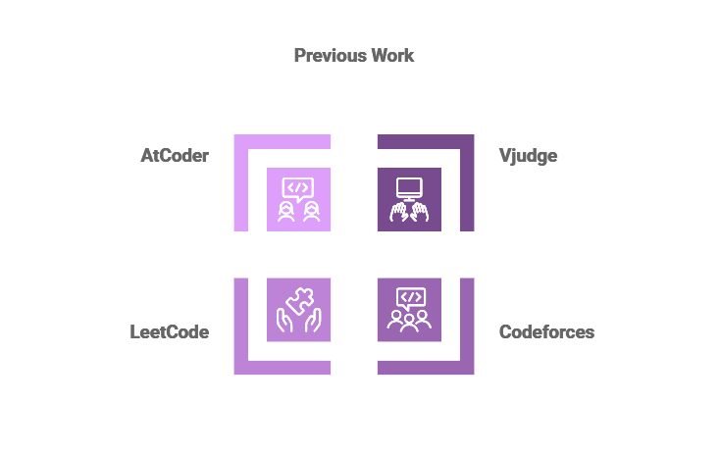
Previous work

Slide 14
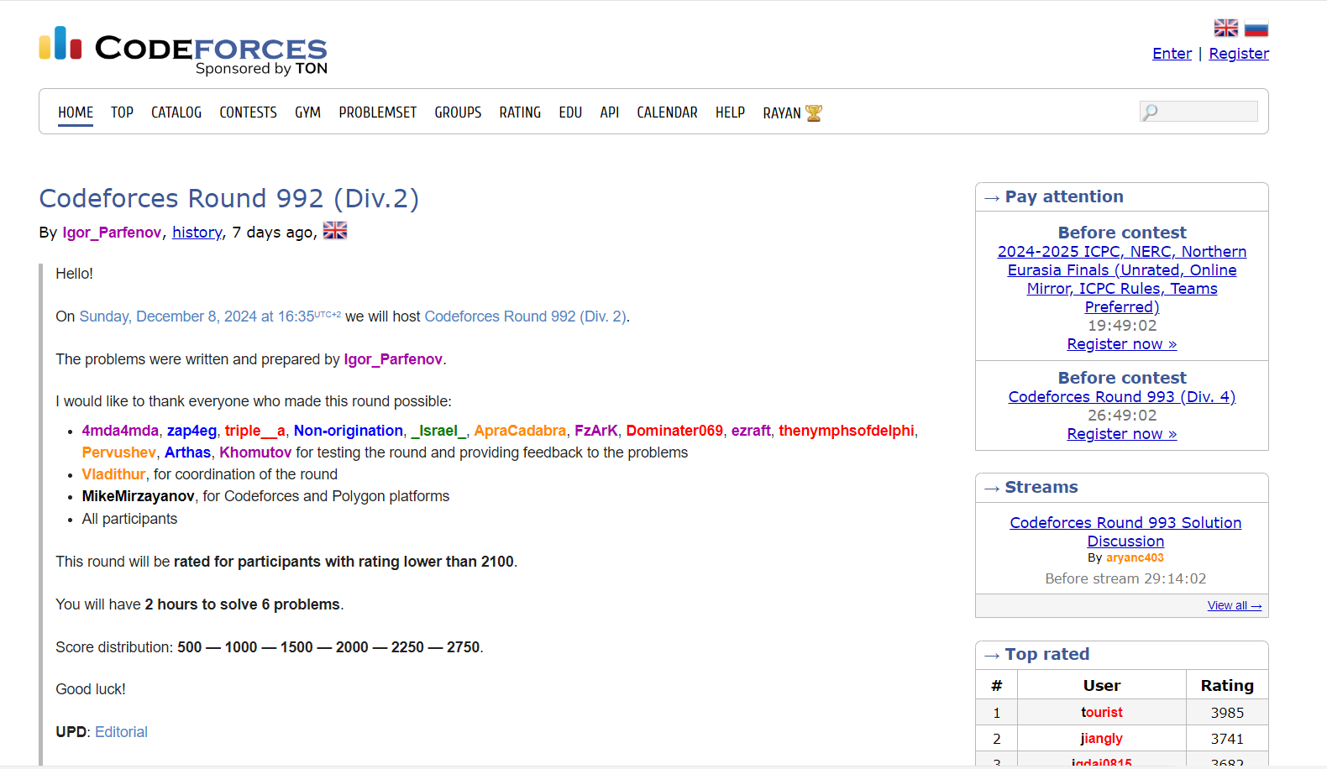
Codeforces
Advantages
1- Practice Platform: Virtual contests are excellent for skill-building.
2- Open Access: Available to everyone with no restrictions on content access.
3-Solution Sharing: Users can view others' solutions after solving problems.
4- User Search: Easily find users by entering a substring of their name.
.
Disadvantages
1- Limited Debugging Tools: No support for performance analysis or step-by-step feedback
2- Lack of Cross-Platform Integration: Codeforces doesn't connect with other platforms, requiring manual switching to solve problems

Slide 15
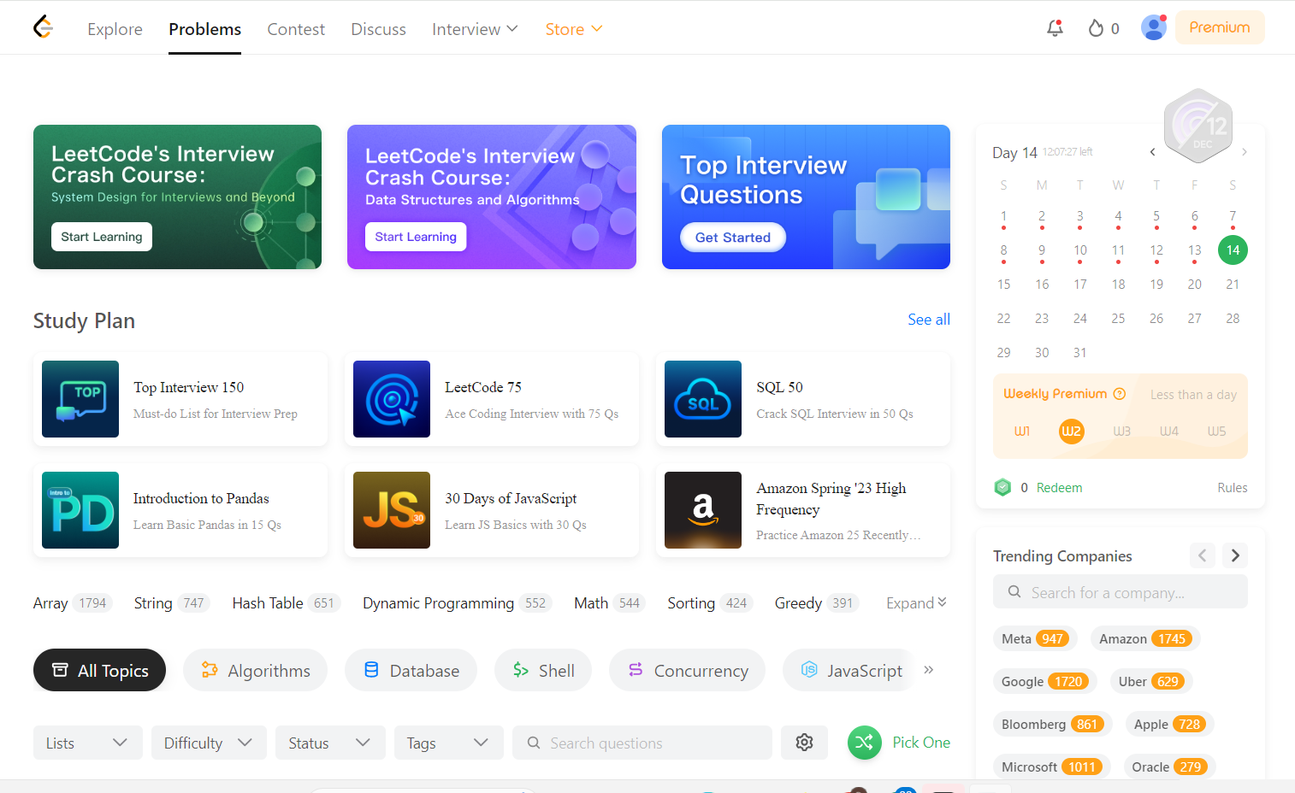
LeetCode
Advantages
Diverse Problem Set: Categorized by company and topic.
Integrated Code Editor: Supports multiple programming languages.
Community Engagement: Discussions and shared solutions.
Disadvantages
1. Limited to Own Problems: No integration with other platforms.
2. Paywall Restrictions: Some features require payment, reducing accessibility

Slide 16
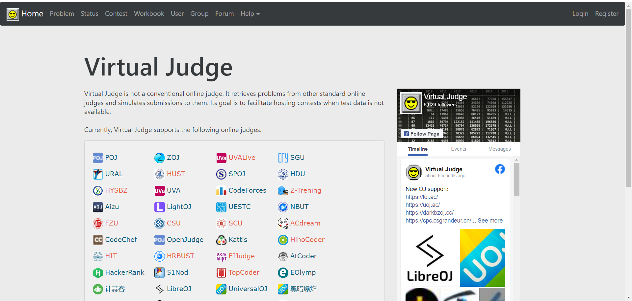
Vjudge
Advantages
1- Multi-Language Support: Supports various programming languages via integrated online judges.
2- Online Judge Integration: Access problems from multiple platforms in one place.
3- Group Contests: Enables team competitions for learning and collaboration.
4- Skill Development: Encourages strategy sharing and interview preparation.
Disadvantages
1- Limited Team Features: No tools for team management, collaboration, or team-specific scoreboards.
2- No Blog Section: Lacks a feature for sharing techniques, solutions, or tips interactively.
3- No Private Problem Creation: Users can’t create or share custom problems.
4- Restricted Problem Flexibility: Limited options for individual or team-specific training.

Slide 17

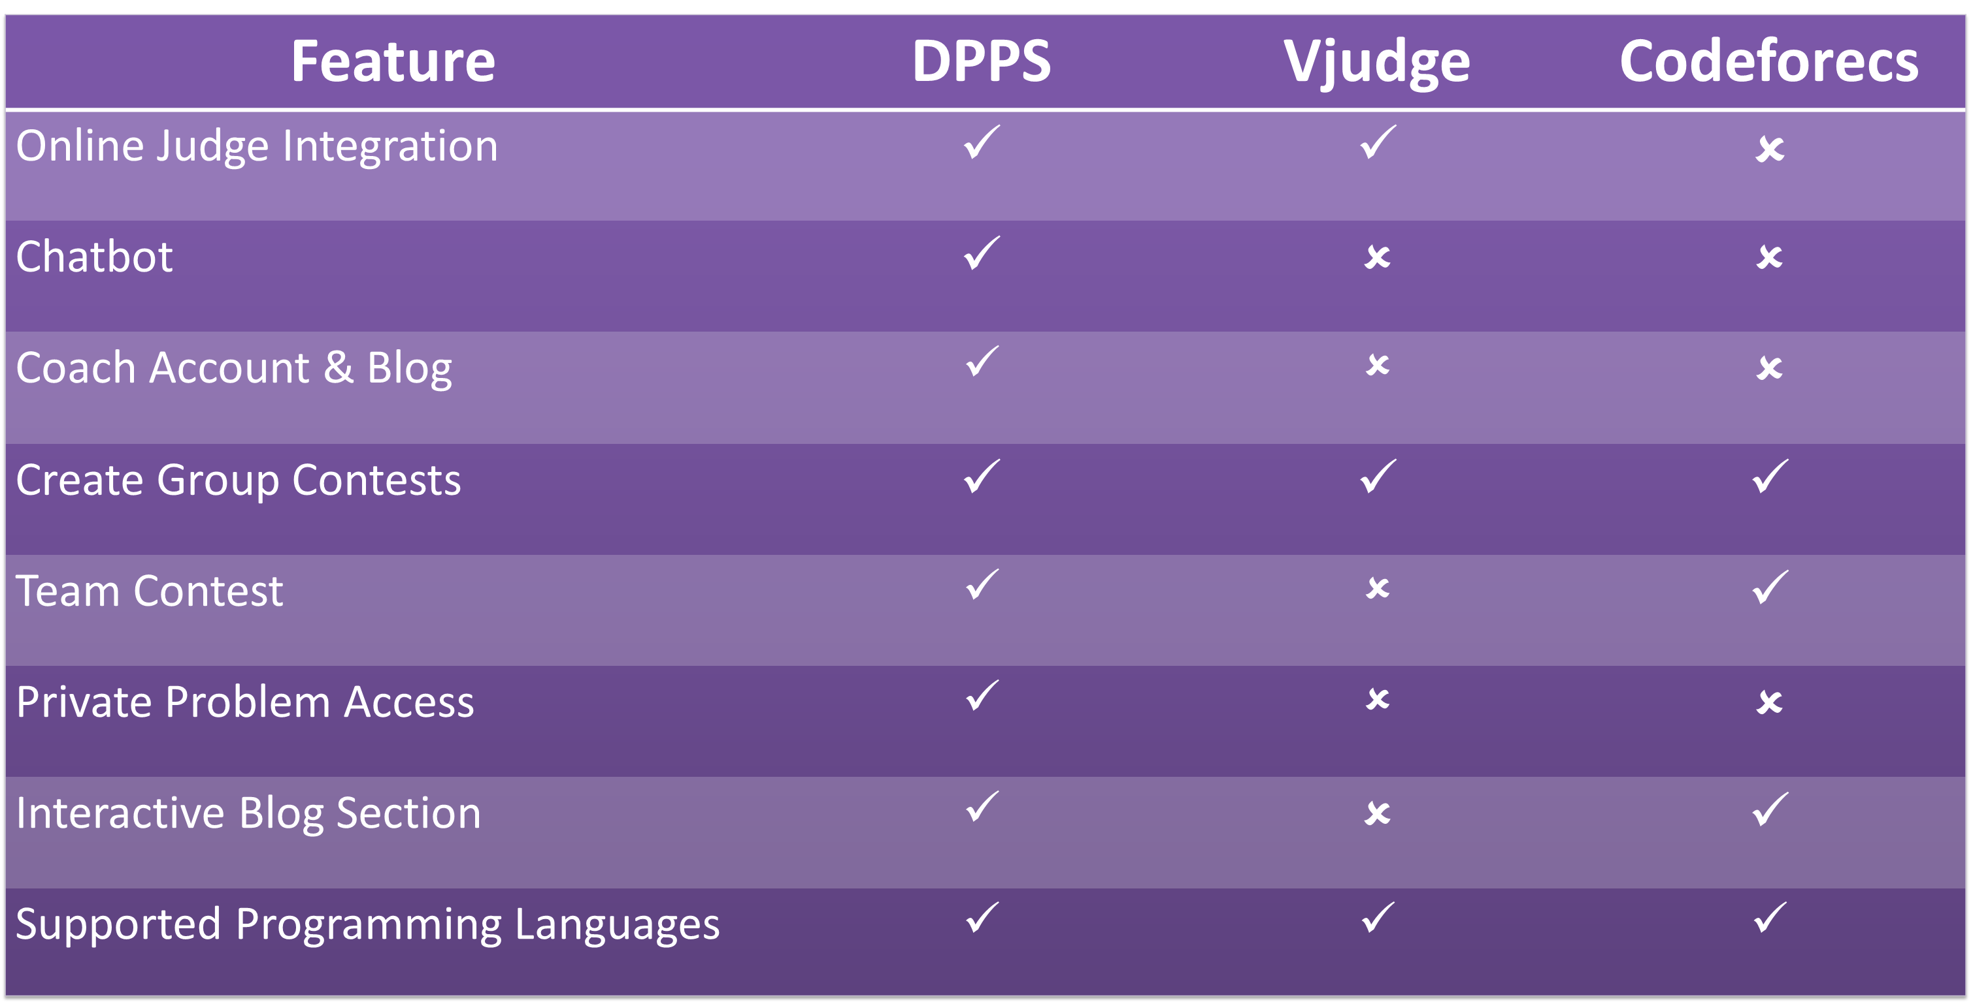
Feature | DPPS | Vjudge | Codeforecs
Online Judge Integration | $$✓$$ | $$✓$$ | $$✗$$
Chatbot | $$✓$$ | $$✗$$ | $$✗$$
Coach Account & Blog | $$✓$$ | $$✗$$ | $$✗$$
Create Group Contests | $$✓$$ | $$✓$$ | $$✓$$
Team Contest | $$✓$$ | $$✗$$ | $$✓$$
Private Problem Access | $$✓$$ | $$✗$$ | $$✗$$
Interactive Blog Section | $$✓$$ | $$✗$$ | $$✓$$
Supported Programming Languages | $$✓$$ | $$✓$$ | $$✓$$

Slide 18
06.
Features

Slide 19
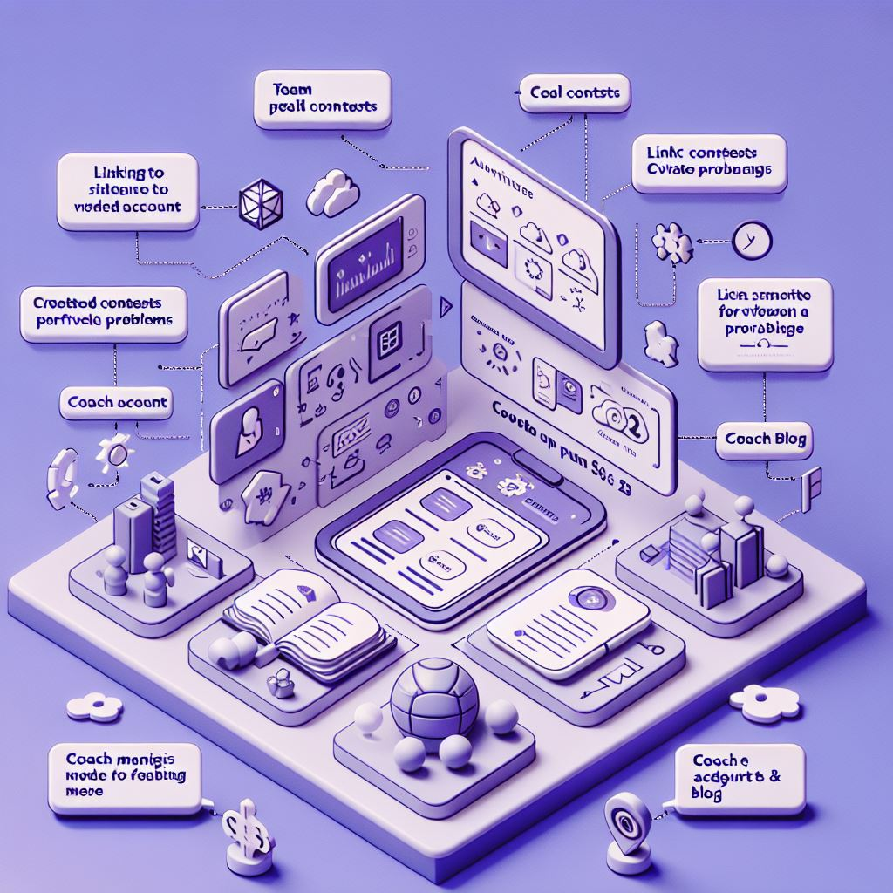
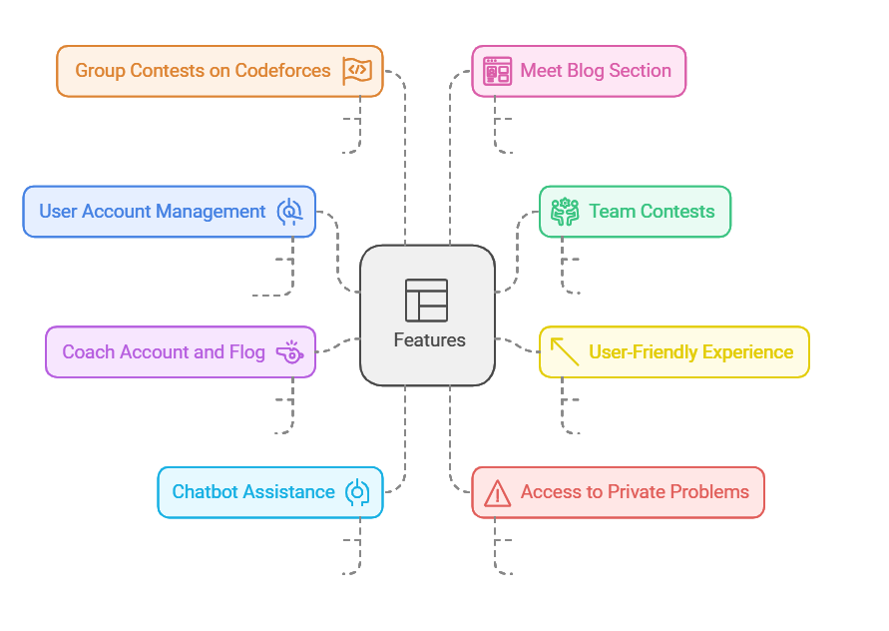
Features

Slide 20

Challenge
1. Integration with Other Platforms: Varying APIs of platforms like Codeforces and LeetCode require significant effort to ensure smooth and efficient integration.
5. User Experience and Design (UX/UI): Balancing attractive design with ease of use to meet both visual and functional expectations.
6. Security and Data Protection: Safeguarding user data against breaches and cyber threats by applying the latest security measures and standards.
2. Designing the Intelligent Chatbot: Developing a chatbot capable of understanding diverse user queries and providing accurate solutions requires advanced AI models and curated training data
7. Database Management: Designing a scalable and flexible database to handle large volumes of data efficiently, ensuring fast processing and retrieval.
3.Account Management (Coach):Creating an interface that allows coaches to manage and monitor trainees’ progress effectively while maintaining user-friendly navigation.
4. Implementing Algorithms: Selecting and implementing suitable algorithms that meet performance and accuracy requirements while keeping the implementation straightforward.
8. Real-Time Data Analysis and Rankings: Delivering accurate real-time analysis and rankings by efficiently handling large-scale, dynamic data.
9. Learning and Implementing Frontend and Backend Technologies :Challenges in mastering and integrating technologies:
- Frontend: HTML, CSS, Bootstrap, React.js
- Backend: ASP.Net Core

Slide 21


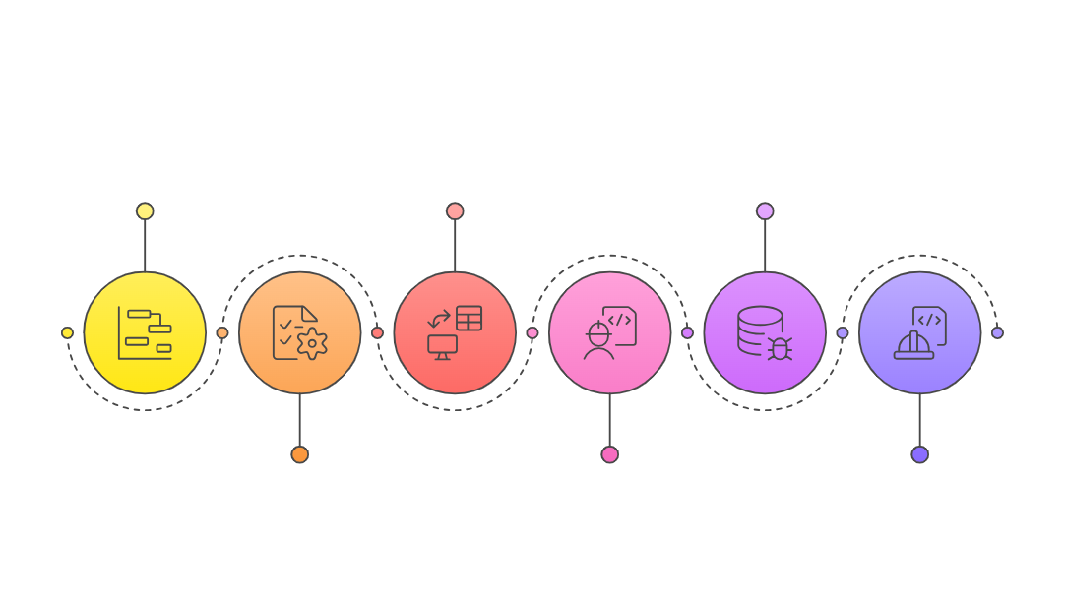

System Development Life Cycle (SDLC)

Slide 22
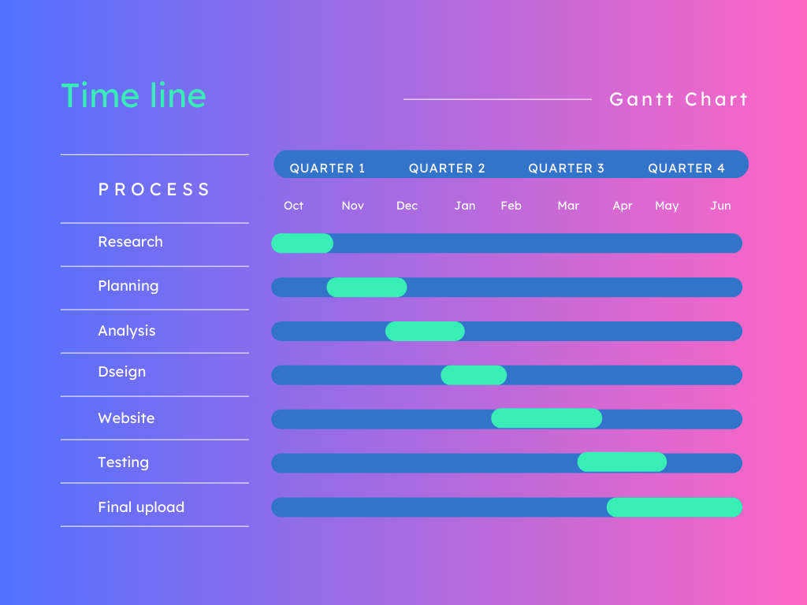

Slide 23
Requirements Analysis
Functional Requirements
Stakeholder Requirements
Aggregating problems from platforms (Codeforces, LeetCode)
Enabling team contests and collaborative problem-solving.
Providing a chatbot for hints and guidance.
Allowing private problem sets for coaches.
User-friendly interface.
Peer Coaching and Progress Review
General Users Developers/Technical Team: Easy problem-solving interface and access to tools.
Coaches: Manage and monitor trainees efficiently.
Admins: Maintain platform operations and security.
Non-Functional Requirements
Risk Analysis
Secure access to private data and contests.
Real-time response for chatbots and platform interactions.
Integration across various programming platforms.
Availability and Reliability
Performance and Scalability
Compatibility Localization and Internationalization
Inaccurate or Outdated irrelevant problem statements . System Downtime: Server crashes or unavailability can disrupt user access . Performance Issues: Slow website loading or handling of simultaneous users

Slide 24
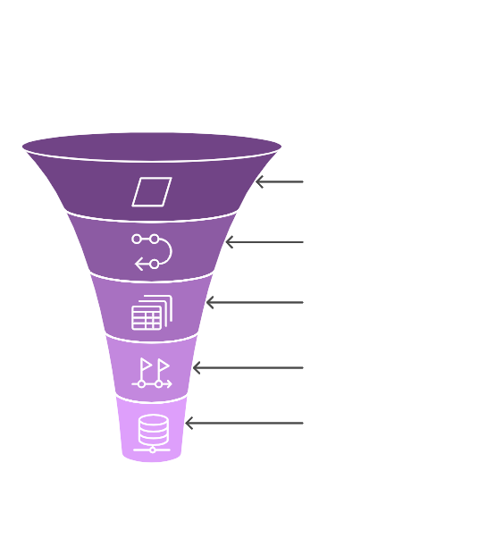
08.
Desgin

Slide 25
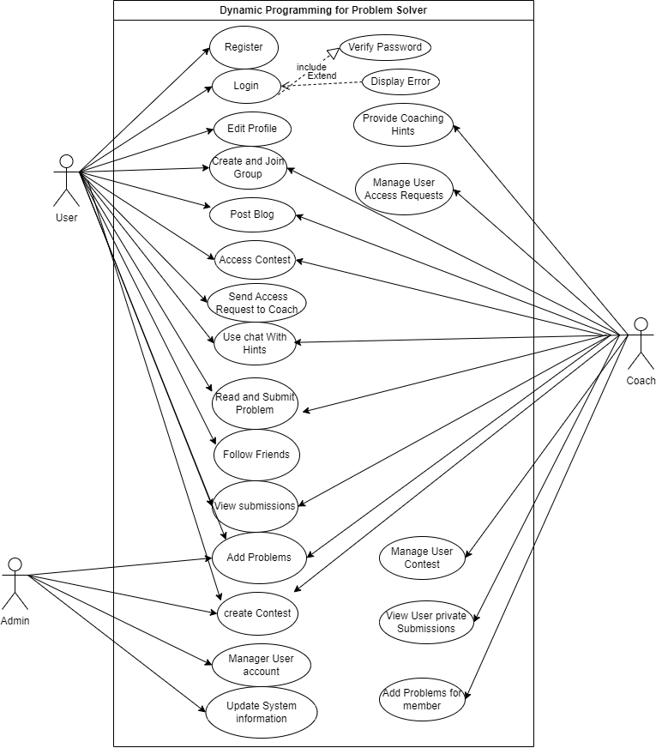
Sequence Diagram
Use case Diagram

Slide 26
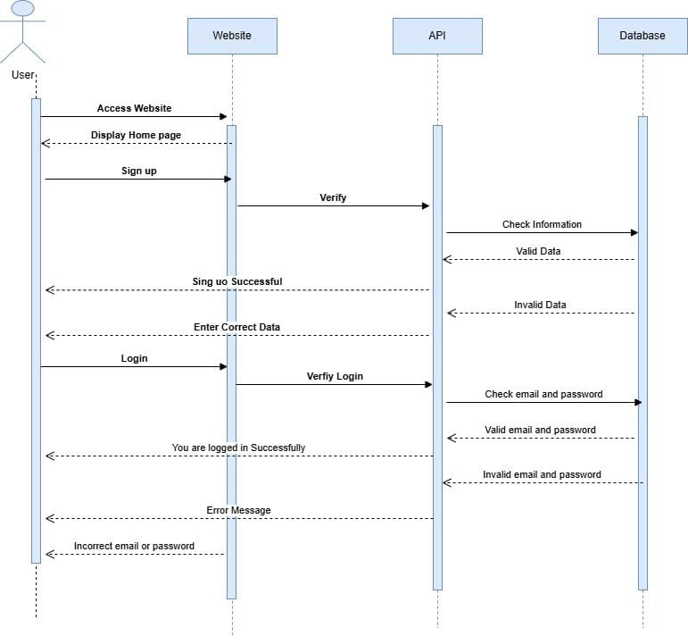
Sequence Diagram
Sequence Diagram
Login/Register

Slide 27
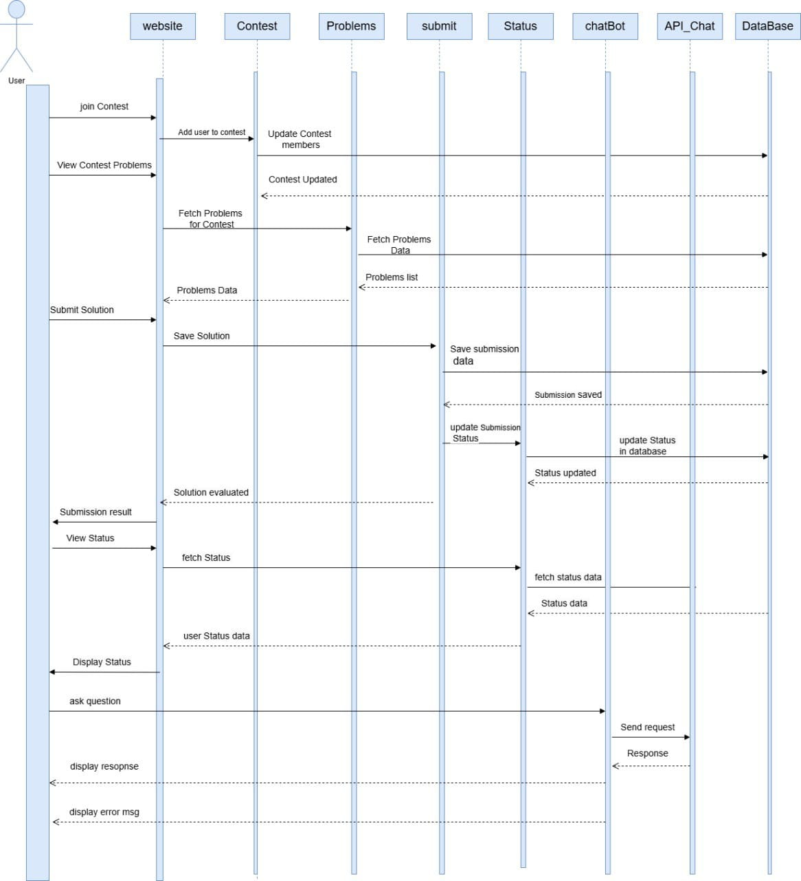
Sequence Diagram
Sequence Diagram
Website

Slide 28
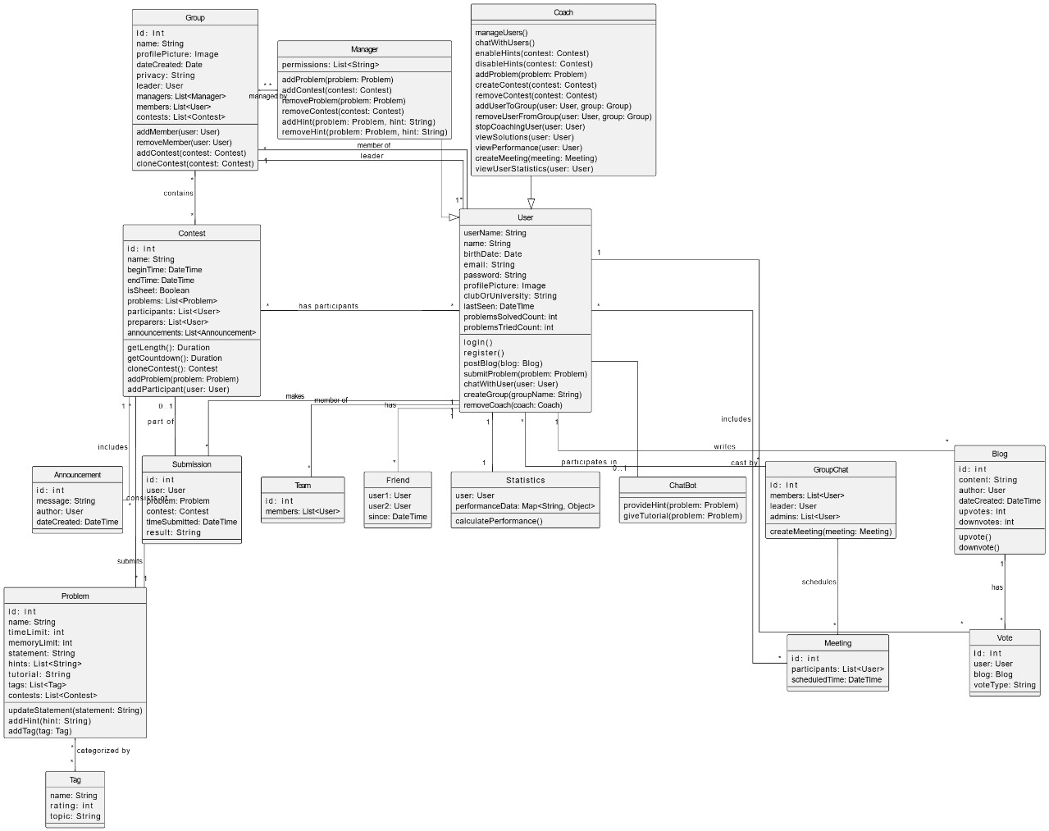
Sequence Diagram
Class Diagram

Slide 29
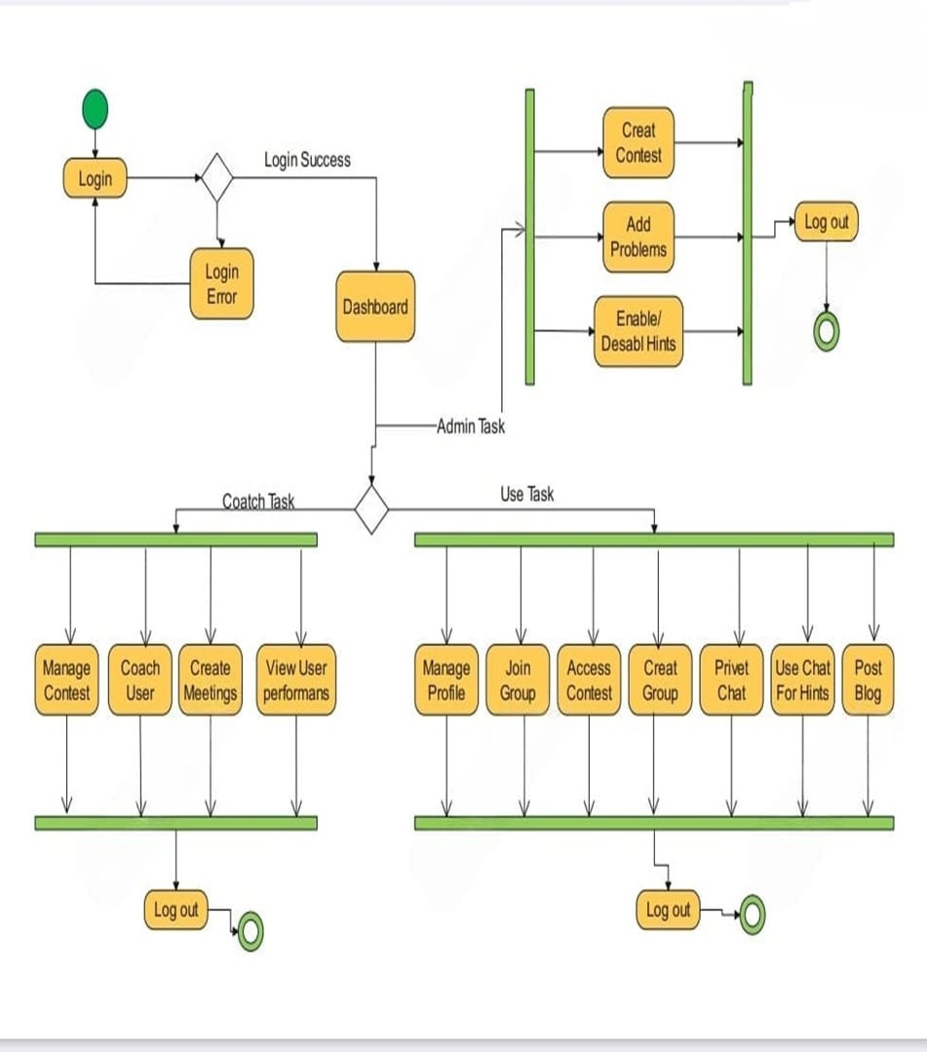
Sequence Diagram
Activity Diagram

Slide 30
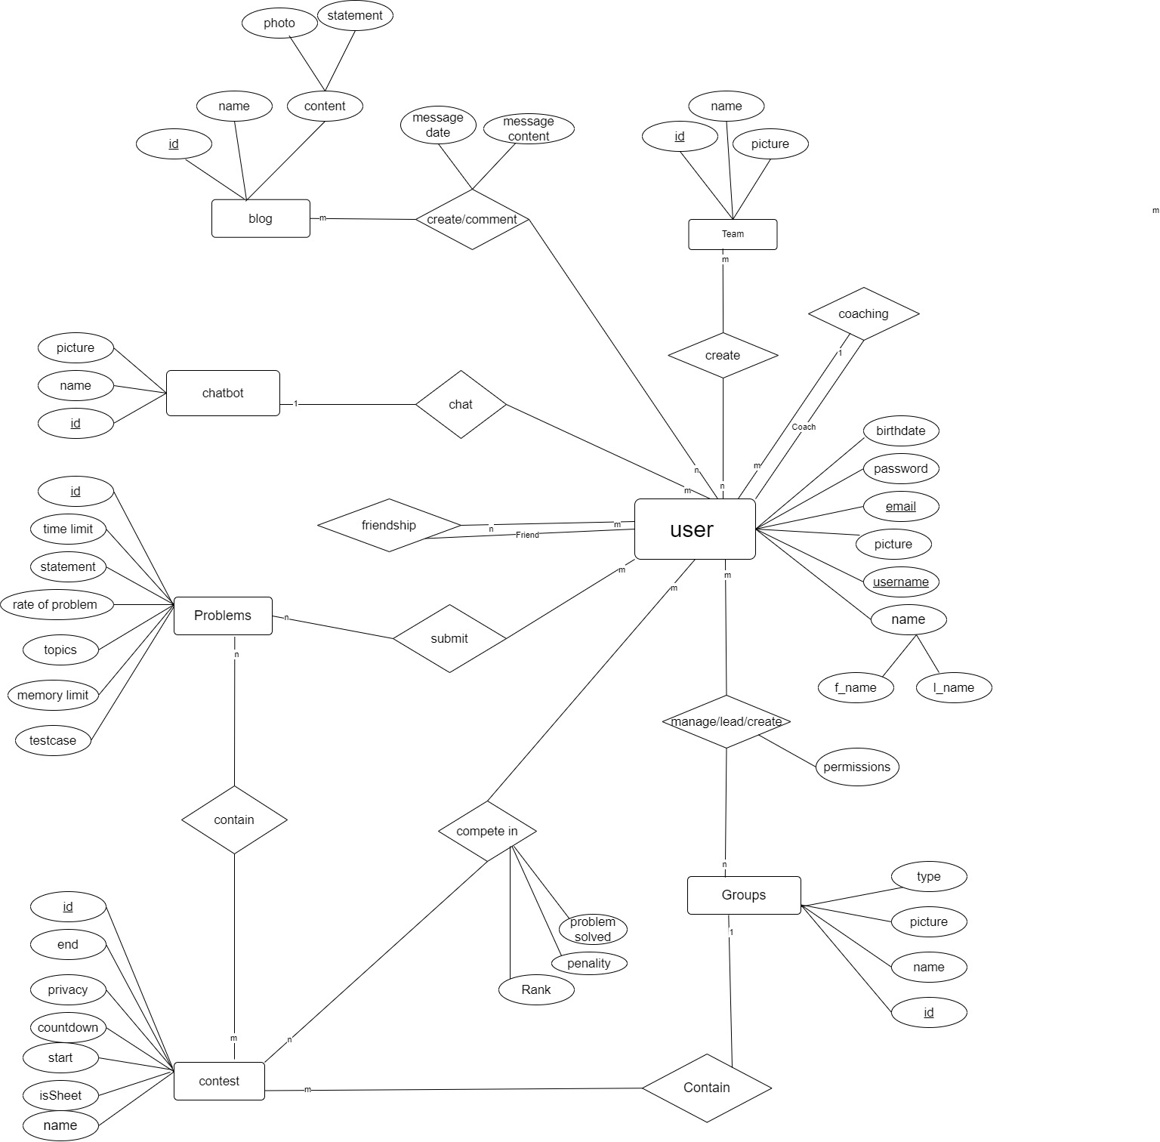
Sequence Diagram
ERD

Slide 31
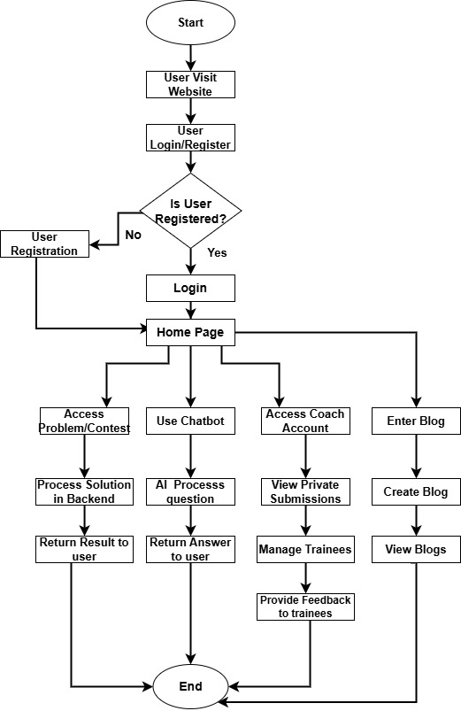
Sequence Diagram
FlowChart Diagram

Slide 32

09.
Prototype

Slide 33
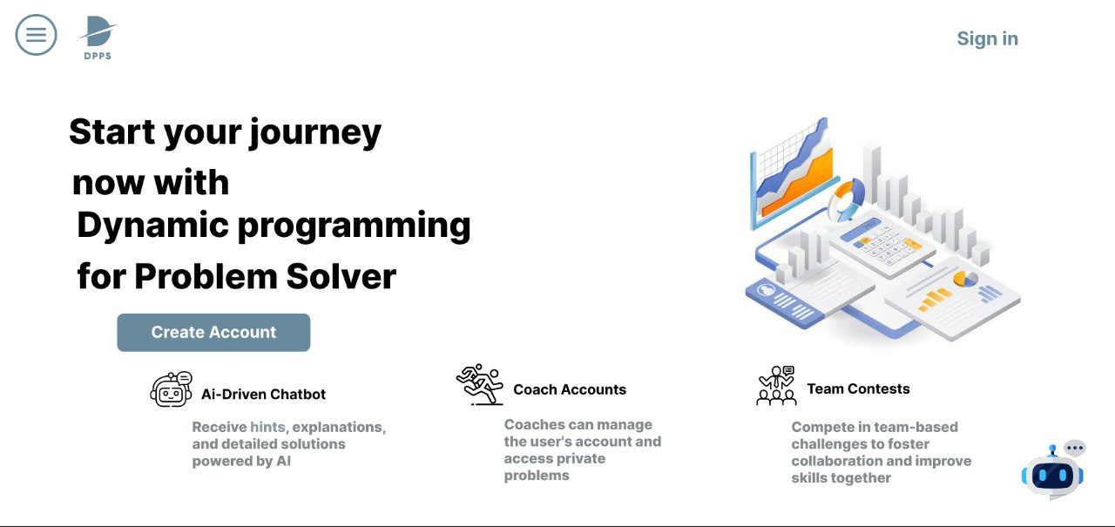

Slide 34
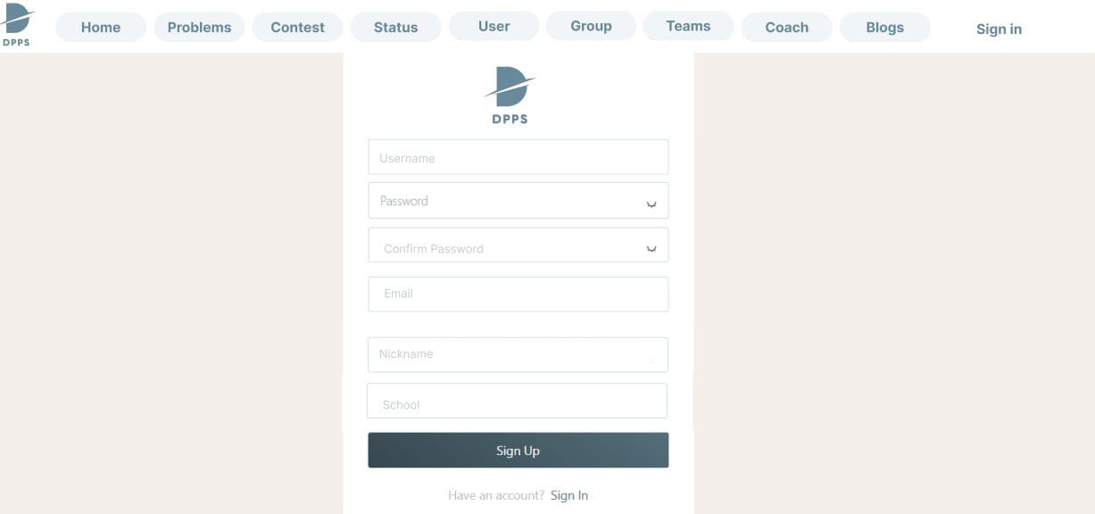

Slide 35
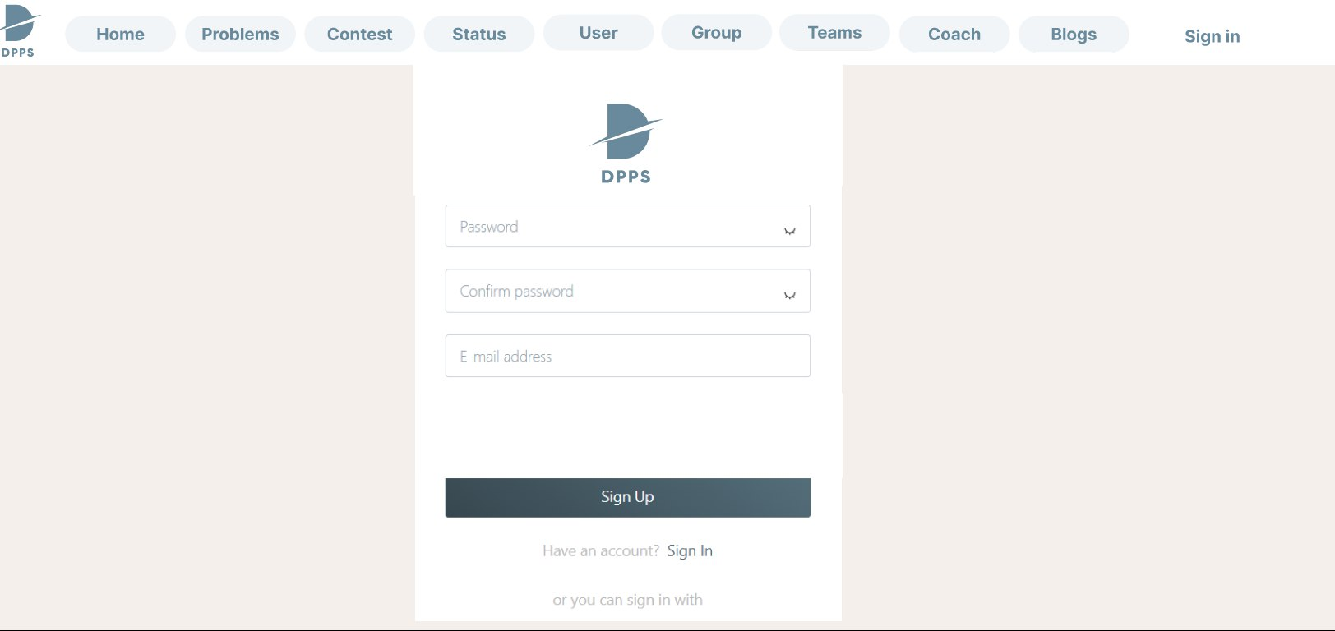

Slide 36
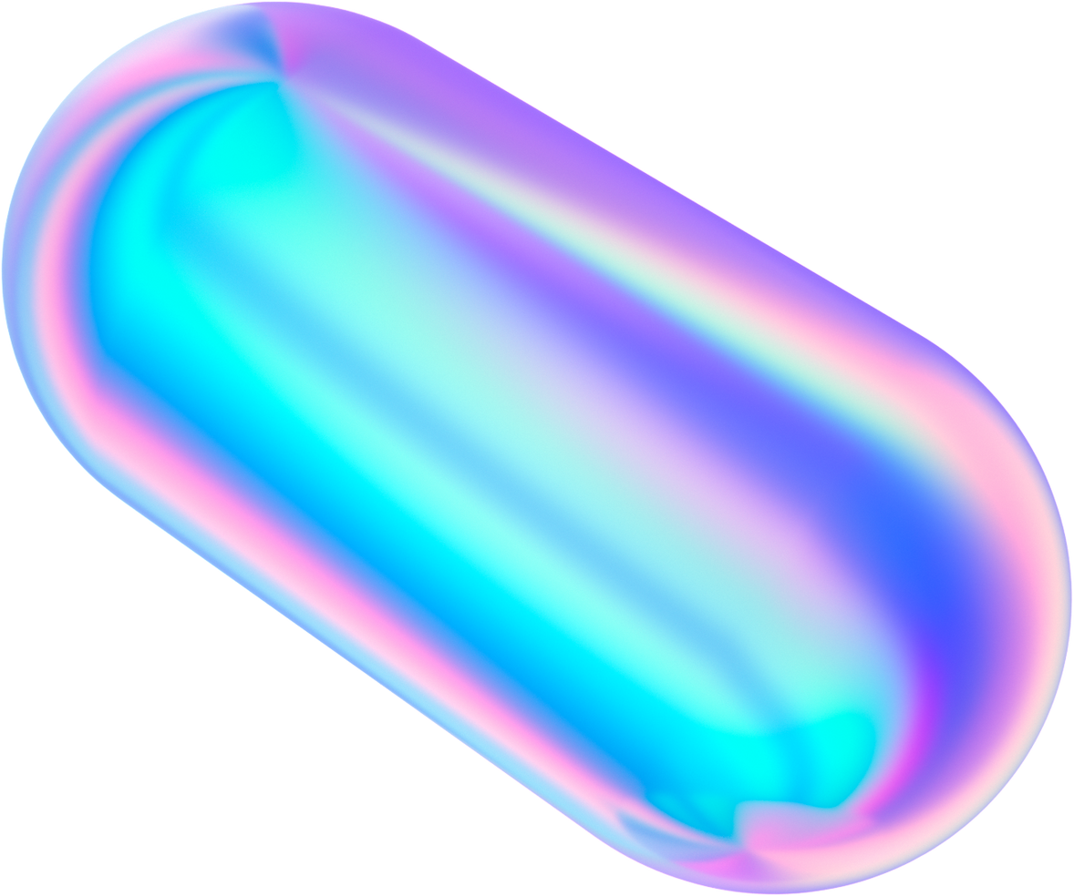
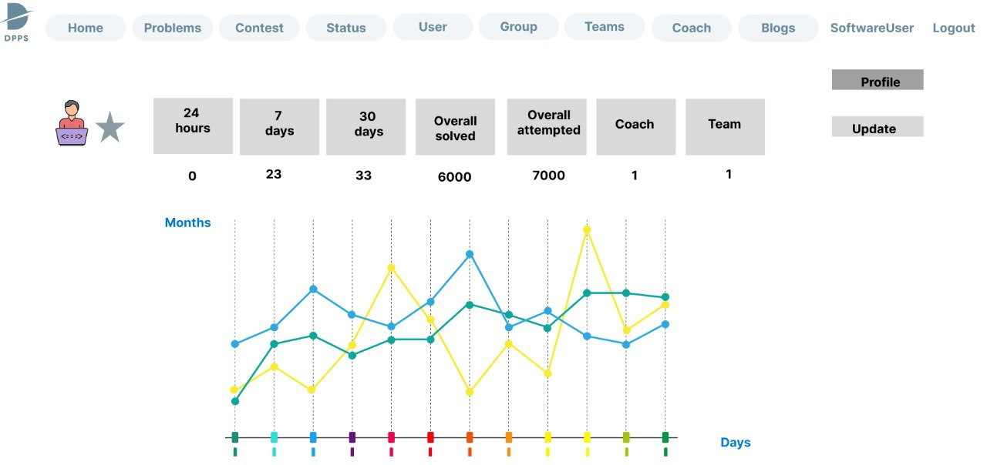

Slide 37
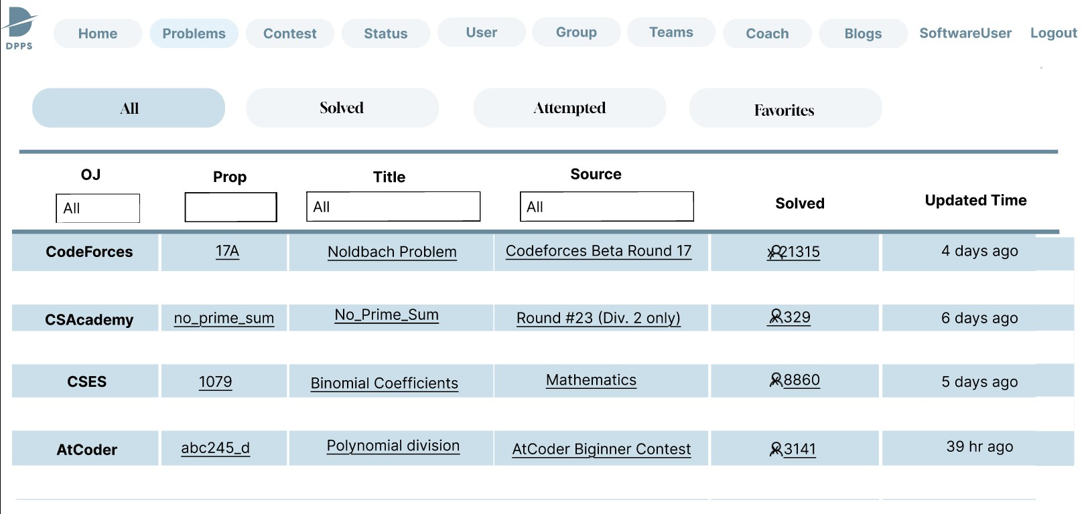

Slide 38
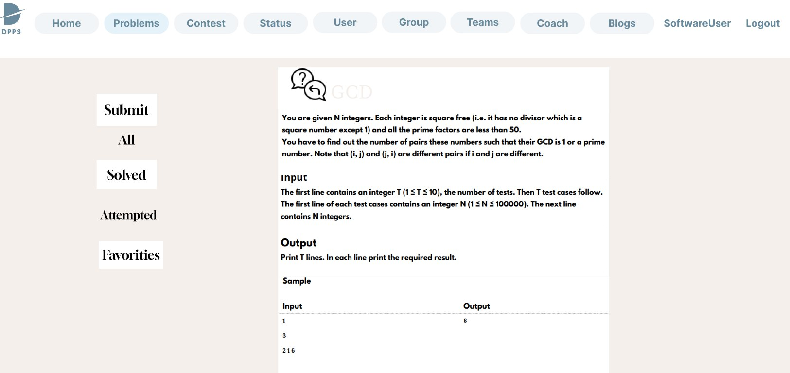

Slide 39
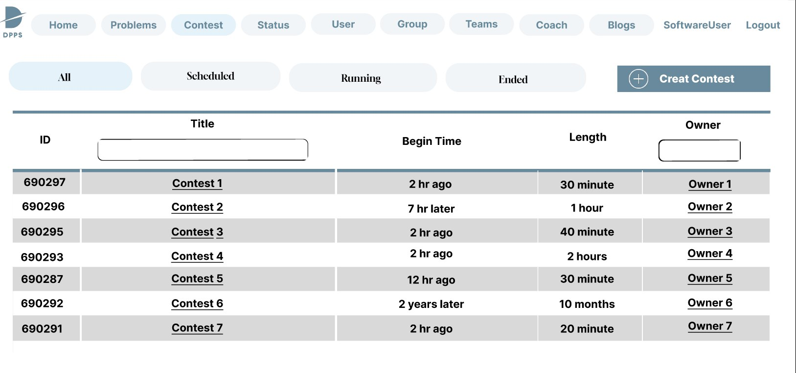

Slide 40
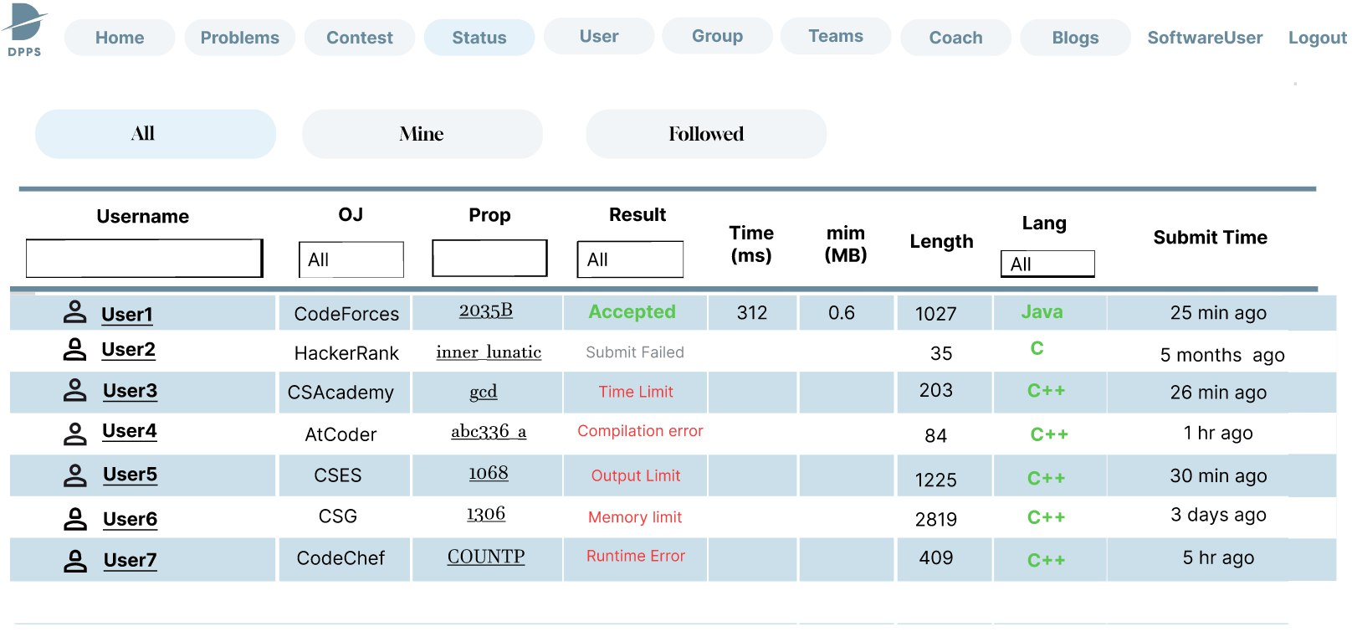

Slide 41
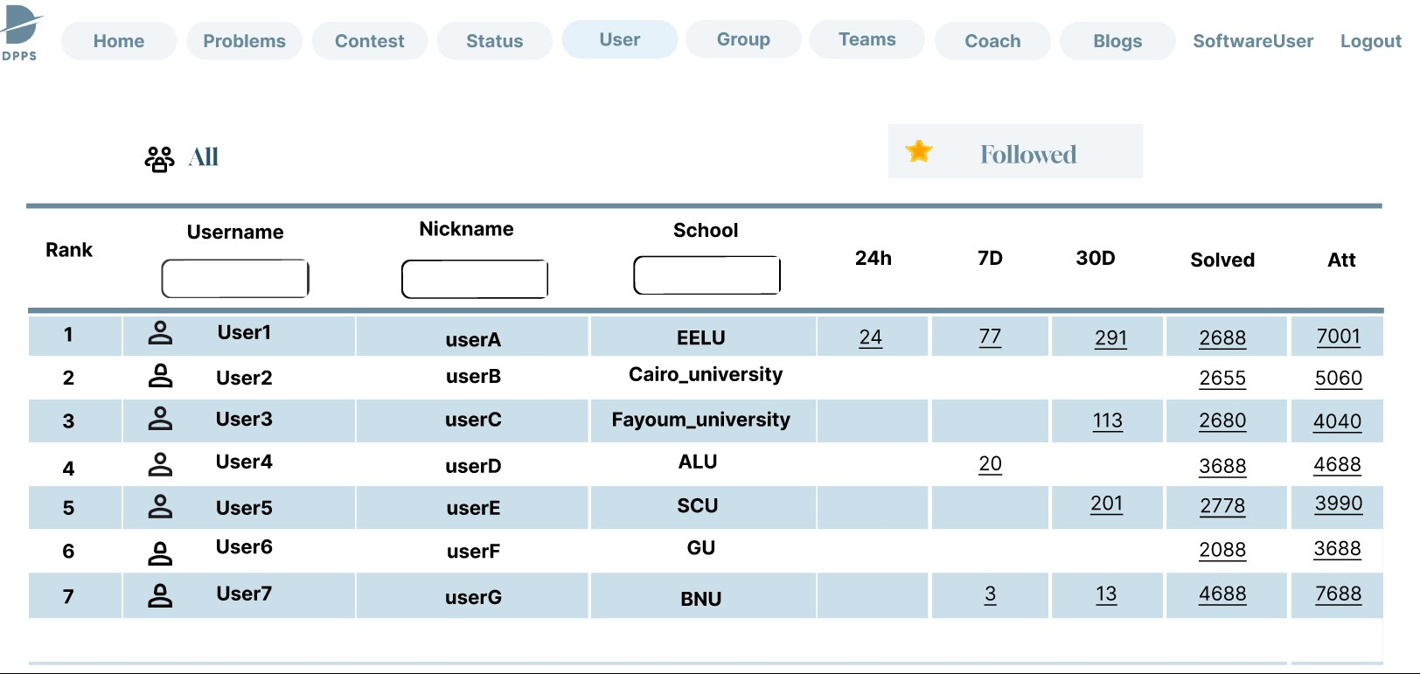

Slide 42
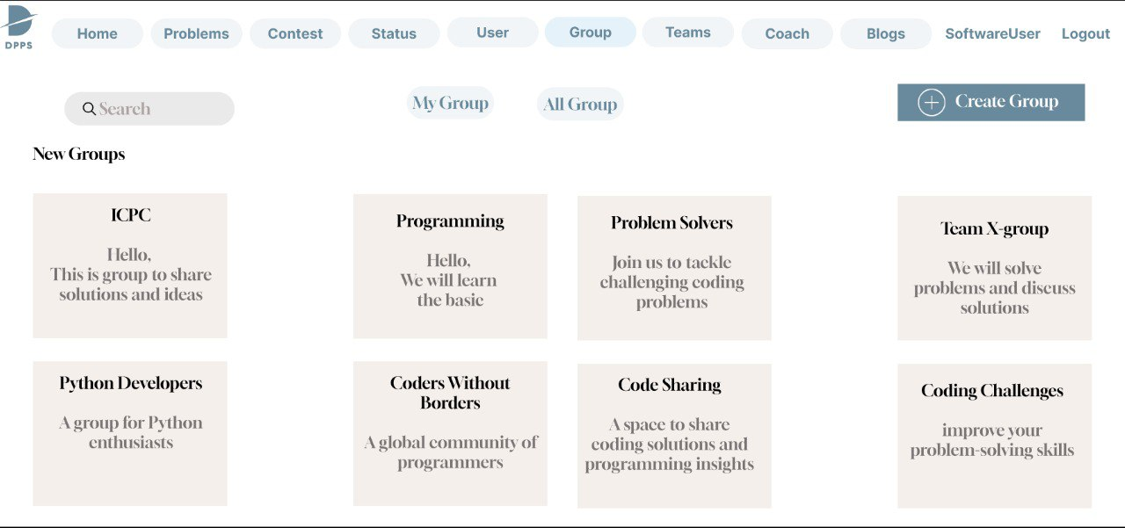

Slide 43
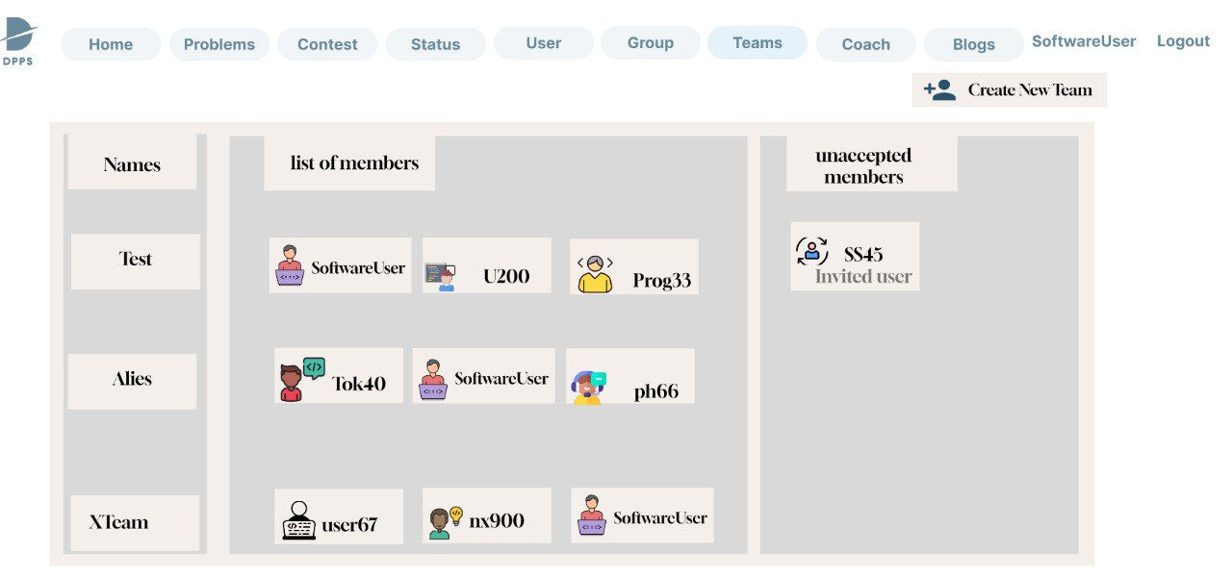

Slide 44
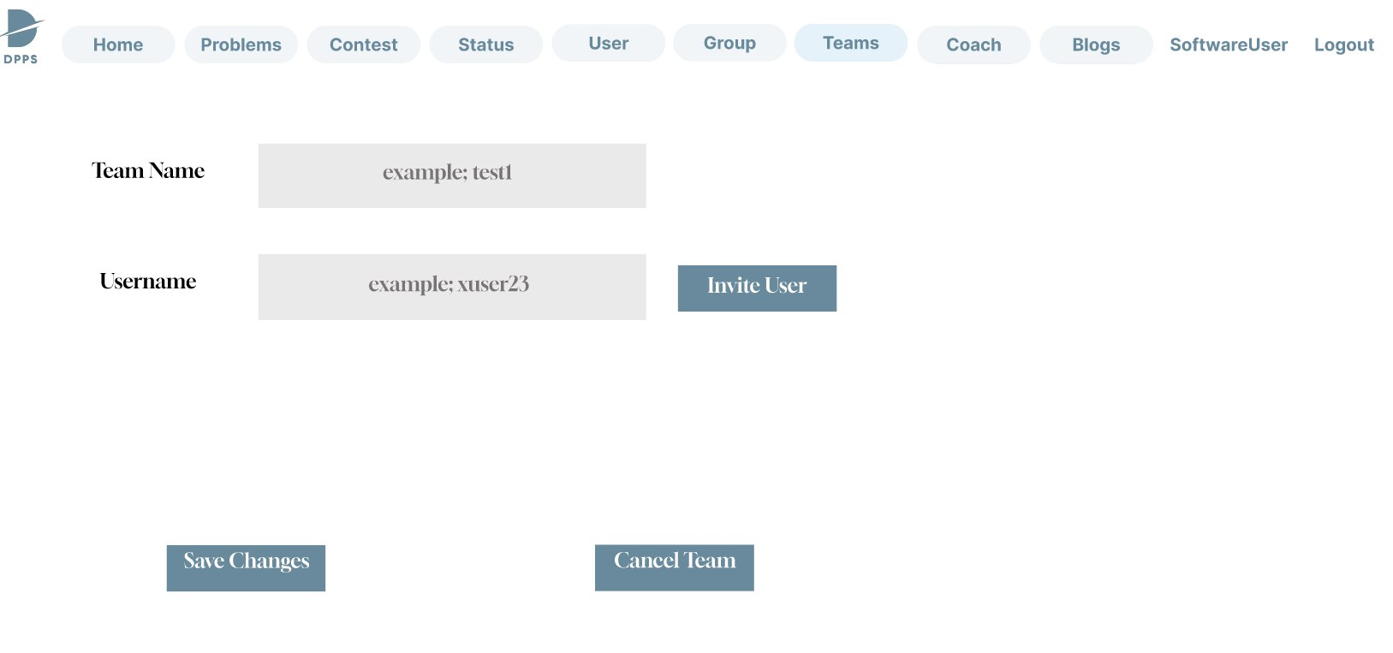

Slide 45
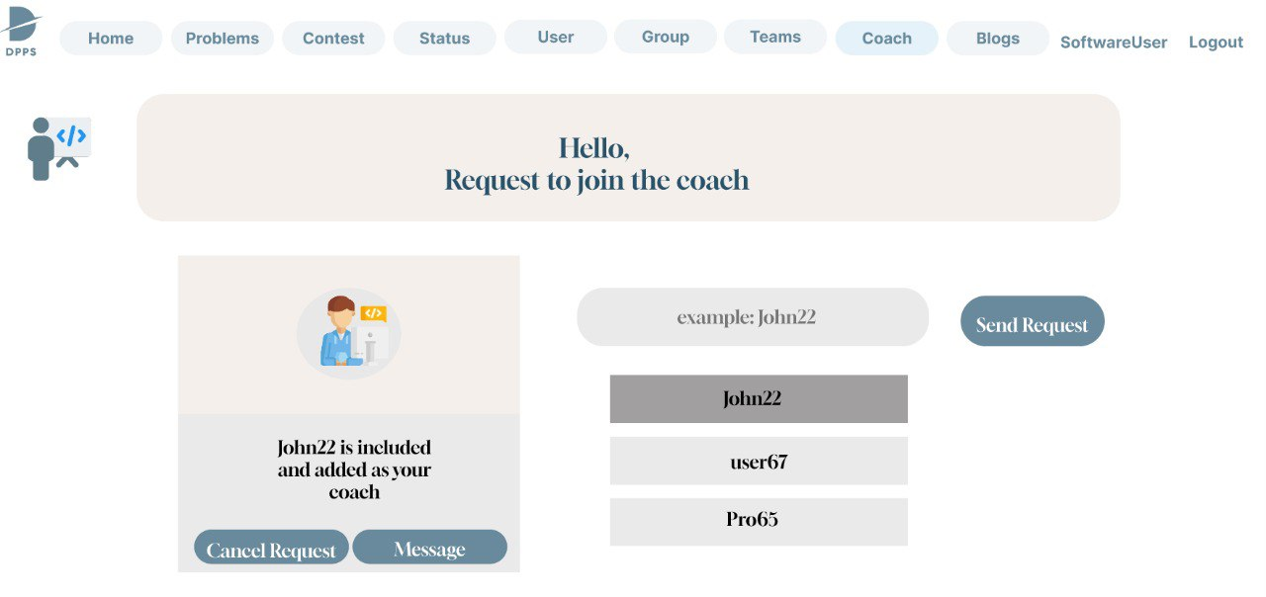

Slide 46
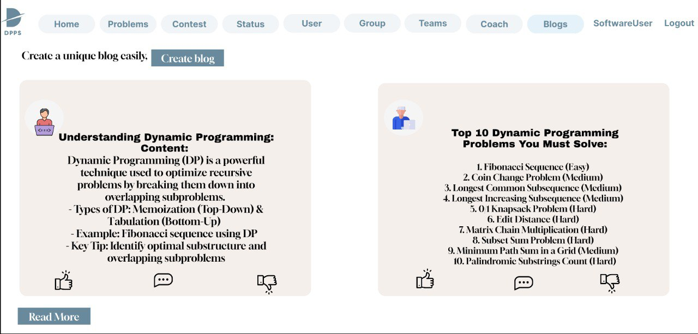

Slide 47
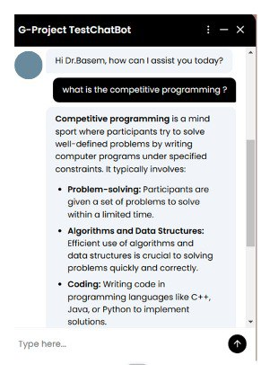
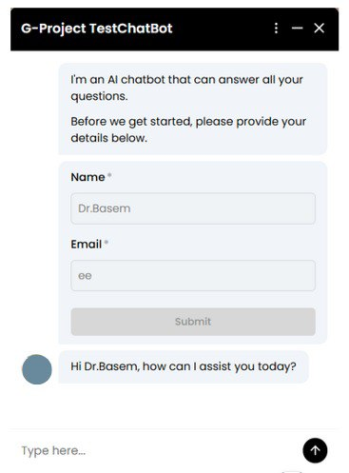
AI Chatbot
The site has a chatbot that assists users in solving problems efficiently.

Slide 48
10.
Implementation Tools

Slide 49



Implementation Tools
Front: HTML, css, bootstrap, react.js
Back : ASP . Net Core
API : chatGPT Api documentation

Slide 50

Conclusion
DPPS (Dynamic Programming for Problem Solver) addresses the critical challenges faced by competitive programmers, teams, and coaches by providing a unified, AI-driven platform. By integrating problems from various sources, enhancing collaboration tools, and empowering coaches with advanced training features, DPFPS streamlines workflows and boosts efficiency. The platform's innovative approach bridges the gaps in existing solutions, offering a seamless and enriched experience for users. Moving forward, DPOCP has the potential to evolve further with enhanced AI capabilities and expanded features, solidifying its role as a transformative tool in the competitive programming ecosystem.

Slide 51
Future Work
While this version achieves core goals, there are several exciting directions for future development:
1. AI-Powered Hints and Feedback Implement an AI assistant to offer personalized hints, feedback on wrong answers, and learning paths based on a user’s history.
2. Test Case Generation and Validation
Add dynamic test case generation for broader edge case coverage, and automate output validation using sandboxed environments.
3. Performance Analytics
Incorporate user analytics dashboards to track growth, success rate, and time efficiency across problem types.

Slide 52


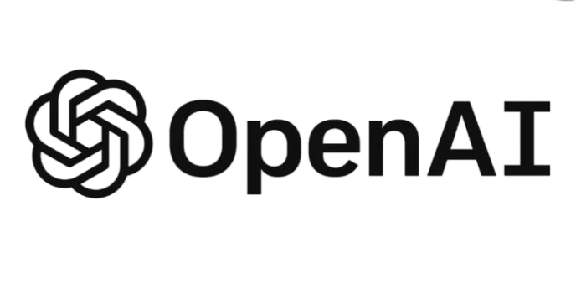
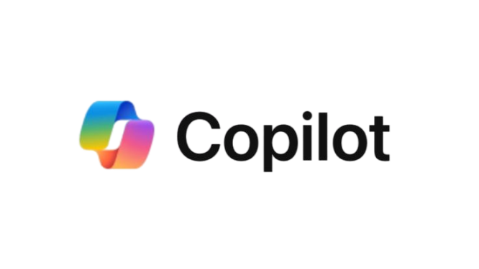


References

Slide 53


